Slide 1
Battleground State:
Characterizing and Understanding Political Bias in News Discourse on Reddit
Mansi Ganatra & Samar Haider
12/2/2019

Slide 2
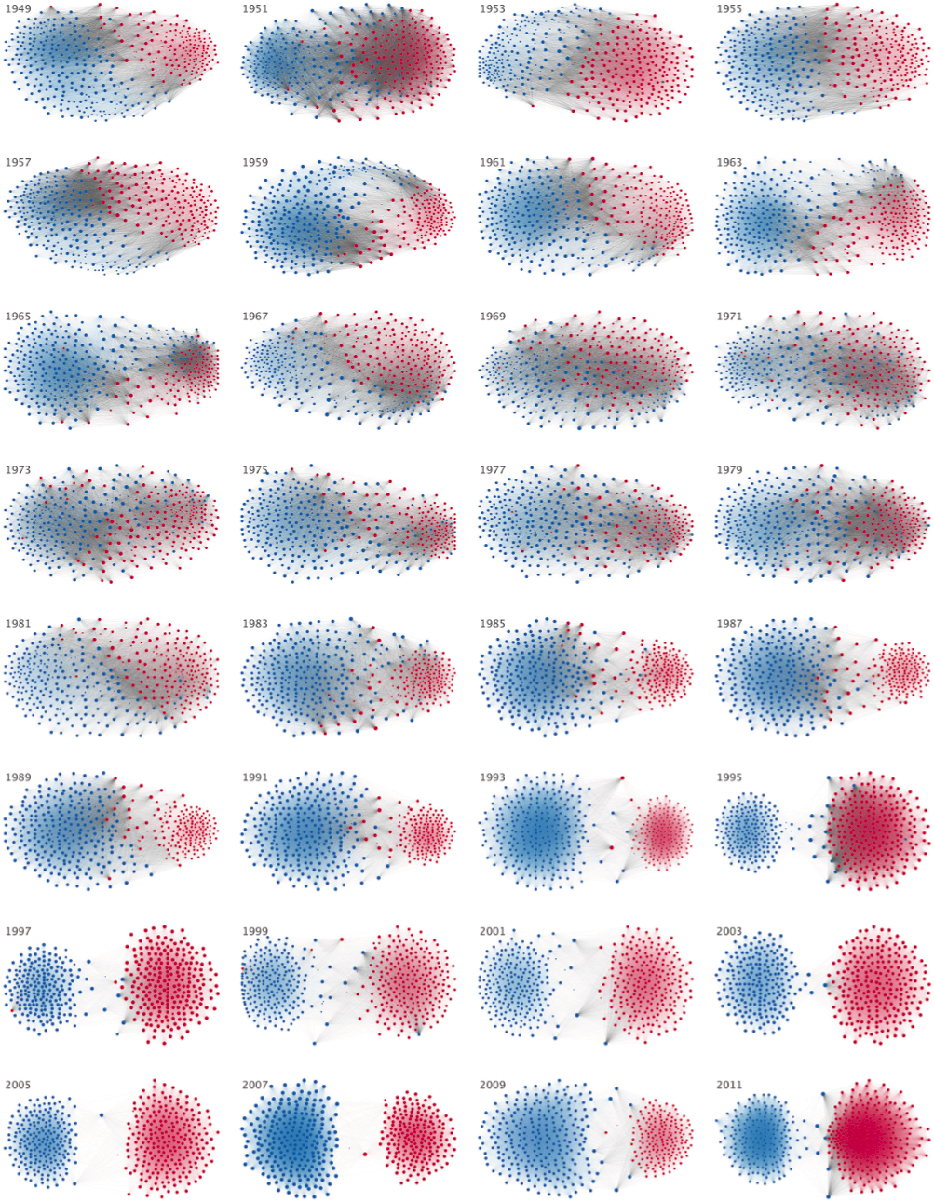
Background
The political landscape in the United States has grown increasingly polarized over the last half century This trend of hyper-partisan politics has led to less cross-aisle cooperation than ever before But political strategy in Congress is driven by the pressure on each member from their constituents
Andirs et. al., The Rise of Partisanship and Super-Cooperators in the U.S. House of Representatives, PLOS One 2015

Slide 3
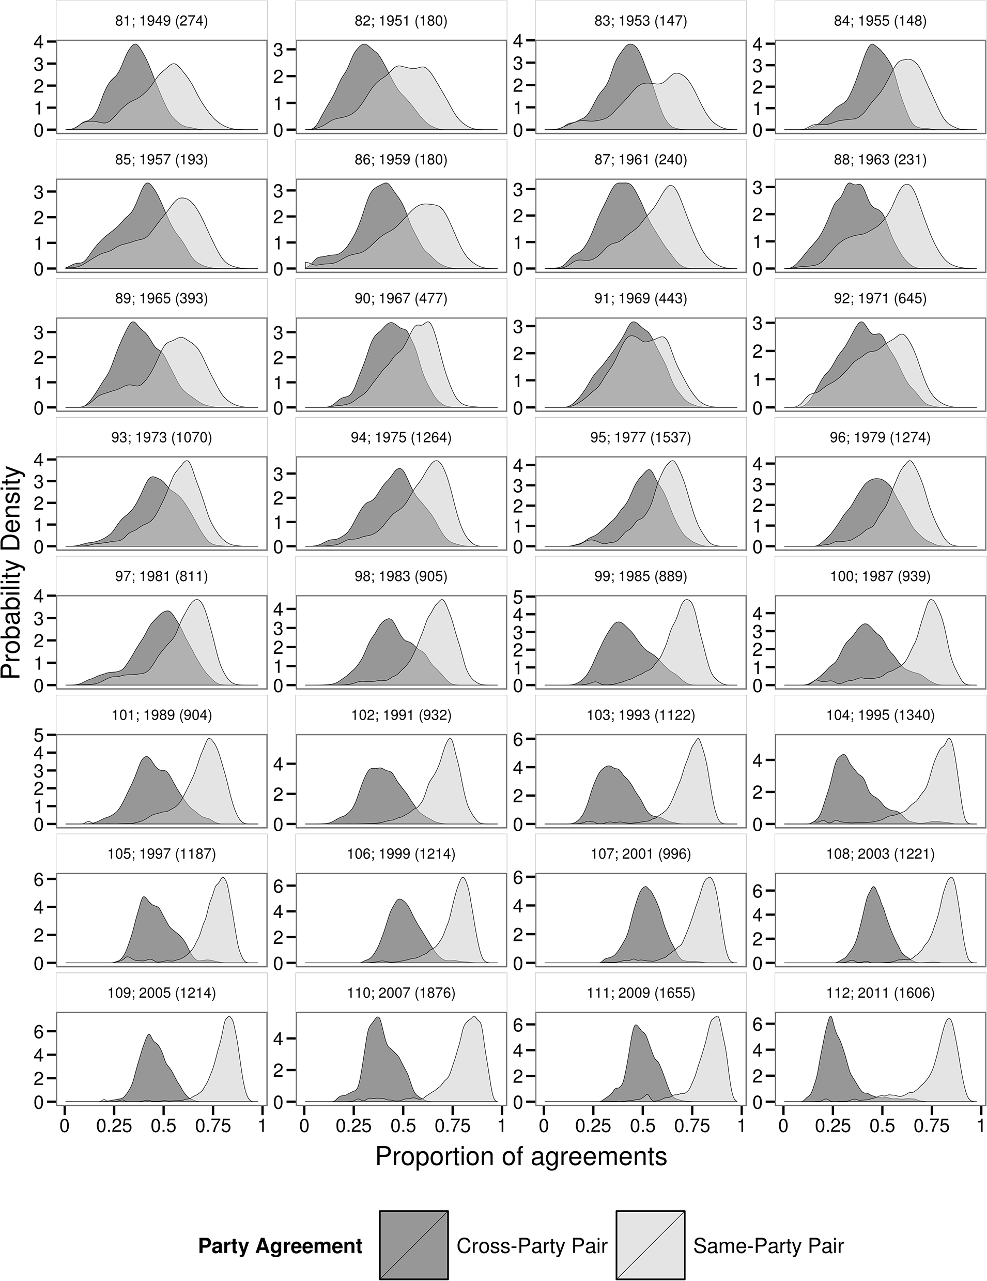
Background
This pressure in turn is driven by the general population’s reaction to news and political commentary The rise of digital media for news dissemination has seen an increase in the formation of echo chambers Such an imbalanced news diet is not healthy for the governance of a republic
Andirs et. al., The Rise of Partisanship and Super-Cooperators in the U.S. House of Representatives, PLOS One 2015

Slide 4
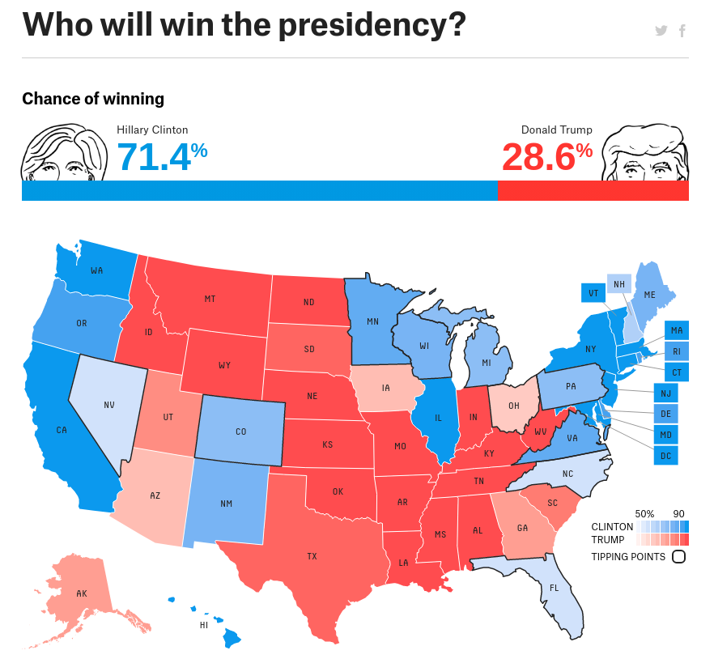
https://projects.fivethirtyeight.com/2016-election-forecast/

Slide 5

Our focus
In this project we investigate the nature of news readership and political discourse on the Internet We use activity on Reddit as a lens through which to understand the conversation surrounding the 2016 U.S. Presidential Election, which saw a ‘surprise’ victory for Donald Trump We analyze the conversation on both neutral and partisan subreddits during the last three months of 2016 to uncover any latent biases in it
reddit.com

Slide 6

Prior work
Most previous work centered around the U.S. elections has focused on Twitter as a testbed for understanding the online conversation While more popular, Twitter does not lend itself to the long-form discussions that take place on Reddit, which can often take the form of argumentation and play a role in swaying people’s opinions Work that uses Reddit data focuses on right- and left-wing communities’ subreddits, and does not investigate their impact and engagement on neutral ground
reddit.com

Slide 7
Research Questions
Is there a media bias in content shared on news and political discourse subreddits?
Does the identity of a media outlet reporting a news story impact a post’s popularity and engagement levels?
Do people from either side of the aisle differ in their level of engagement on neutral news and political discourse subreddits?
Is there a difference in the sentiment of comments mentioning entities from both sides?
Is there a difference in the semantic representation of political entities in comments from local and global subreddits?

Slide 8
Data
Timeframe: October, November, December 2016
Subreddits: news, worldnews, politics hillaryclinton, The_Donald democrats, Republican Liberal, Conservative

Slide 9
Data
Source: pushshift.io Size: Dumps of all submissions and comments made on Reddit for all three months ~ 160 GB Filtered: 1,145,997 submissions 16,234,098 comments
http://files.pushshift.io/reddit/

Slide 10
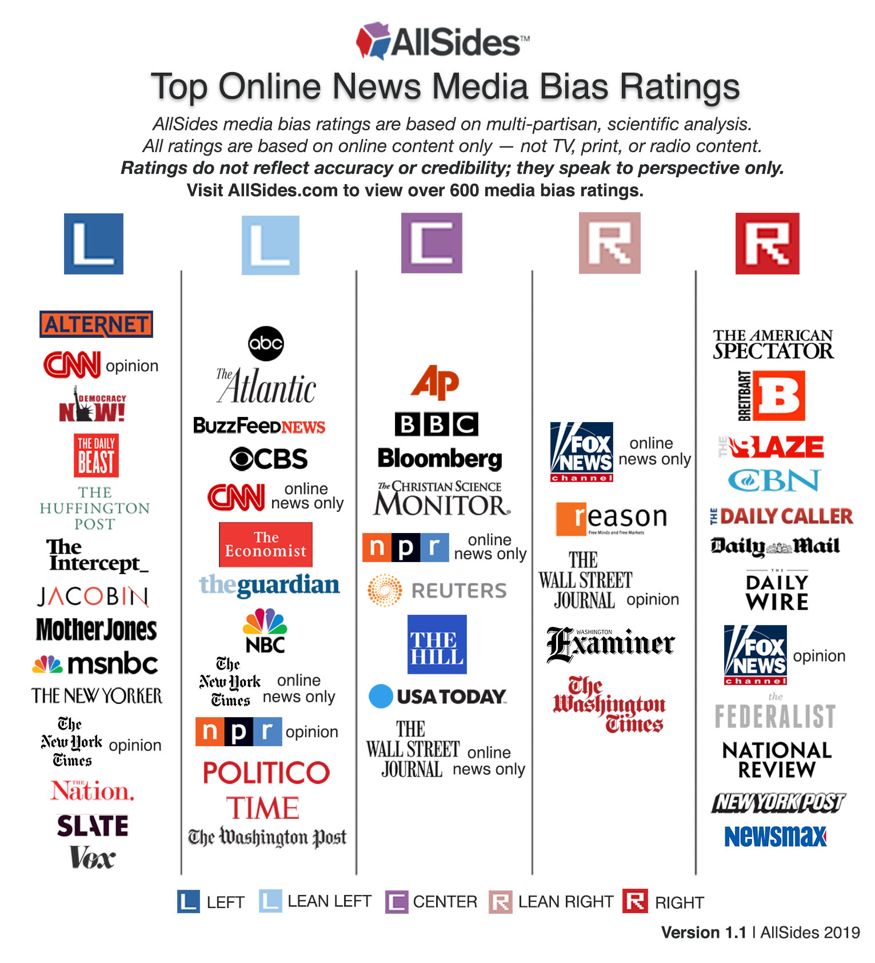
RQ 1: Media bias in submissions on neutral, news subreddits
We use media bias ratings obtained from AllSides to classify submissions as quoting news from either left-, right-, or center-leaning media outlets We then analyze the distribution of submissions from each political leaning as well as the level of engagement with it, across the r/news, r/worldnews, and r/politics subreddits
https://www.allsides.com/media-bias/media-bias-chart

Slide 11
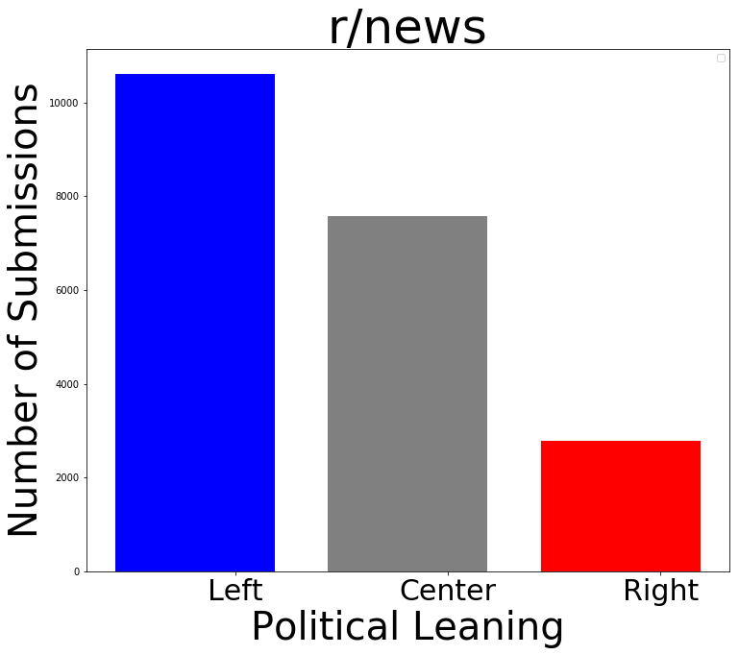
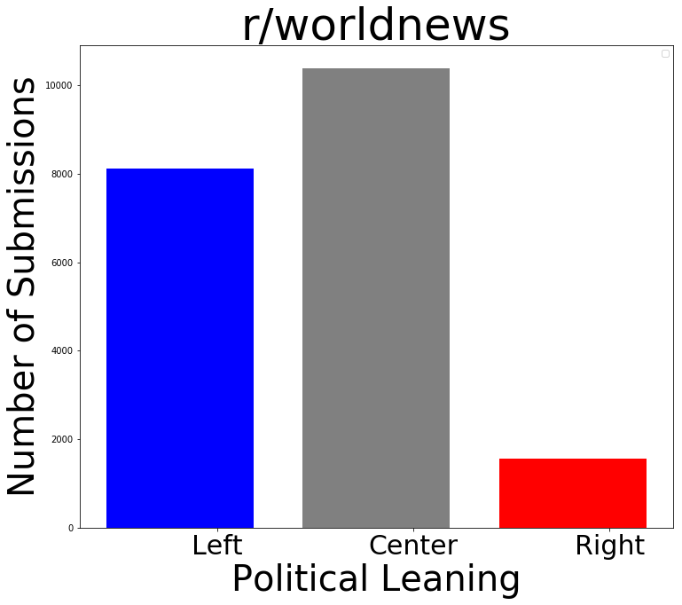
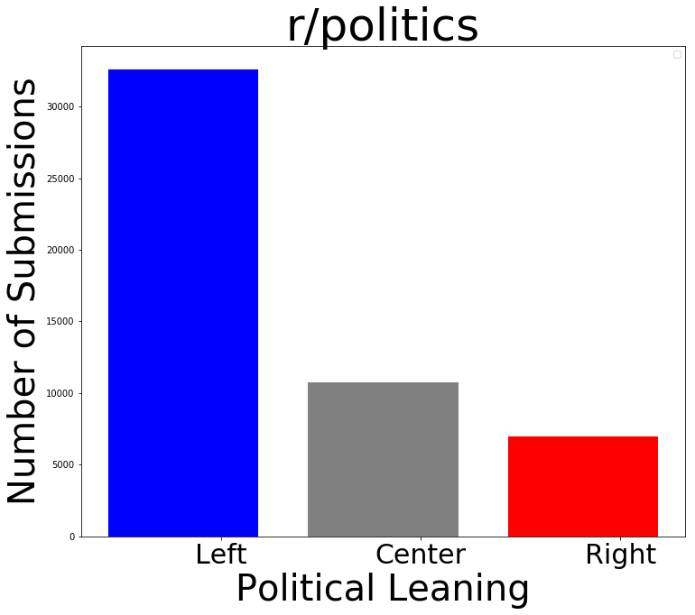
Media bias: number of submissions by leaning
Left-leaning websites are used as sources more often than either center- or right-leaning ones in U.S.-centric subreddits. However, r/worldnews is more centrist.

Slide 12
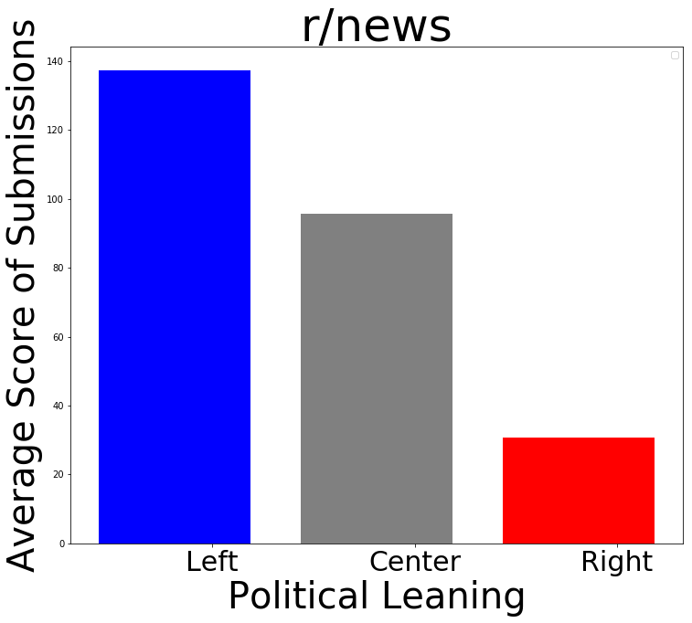
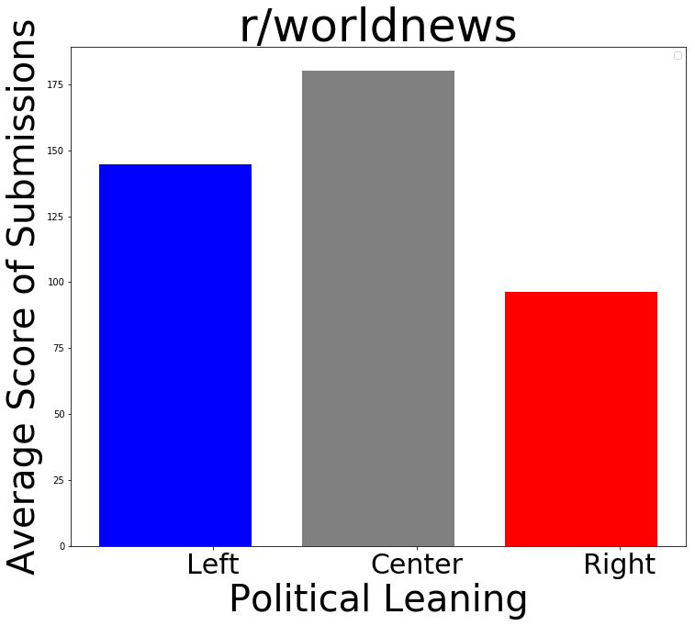
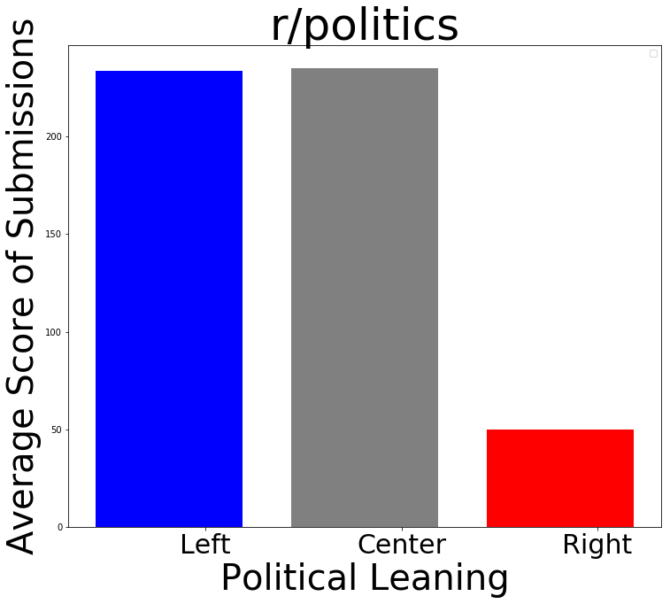
Media bias: popularity of submissions by leaning
Left-leaning websites receive more upvotes than others in r/news but fare identically to center-leaning ones in r/politics. r/worldnews remains centrist.

Slide 13
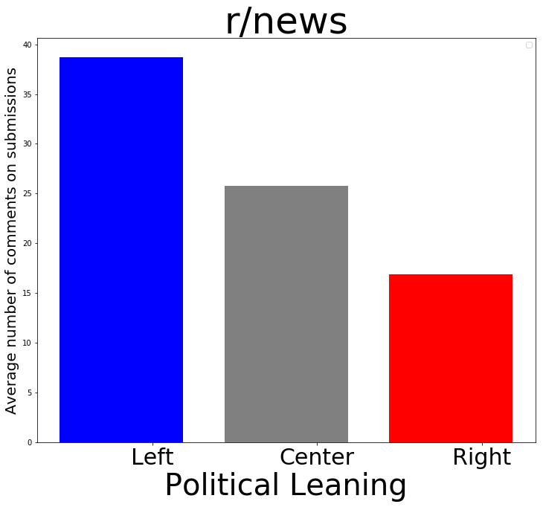
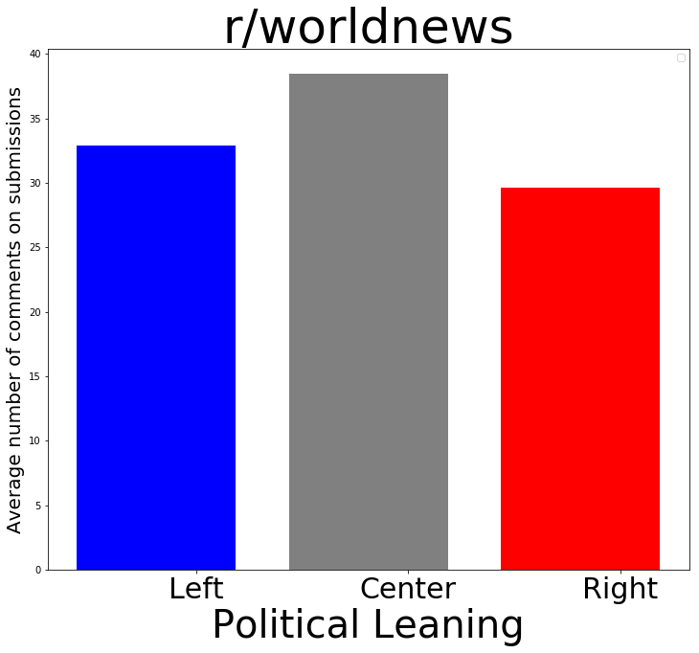
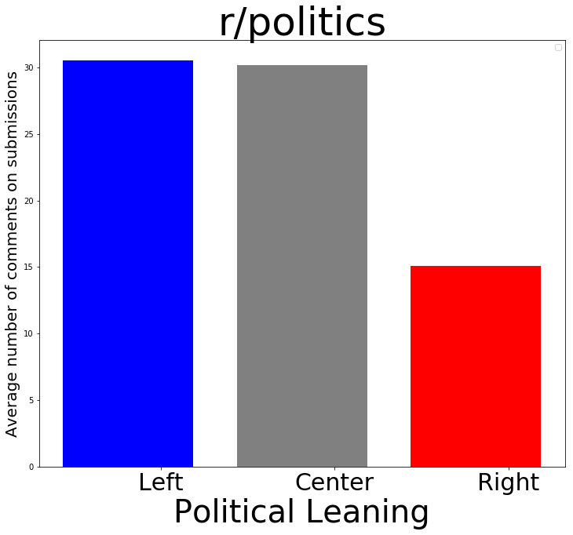
Media bias: engagement on submissions by leaning
Average number of comments on submissions.

Slide 14
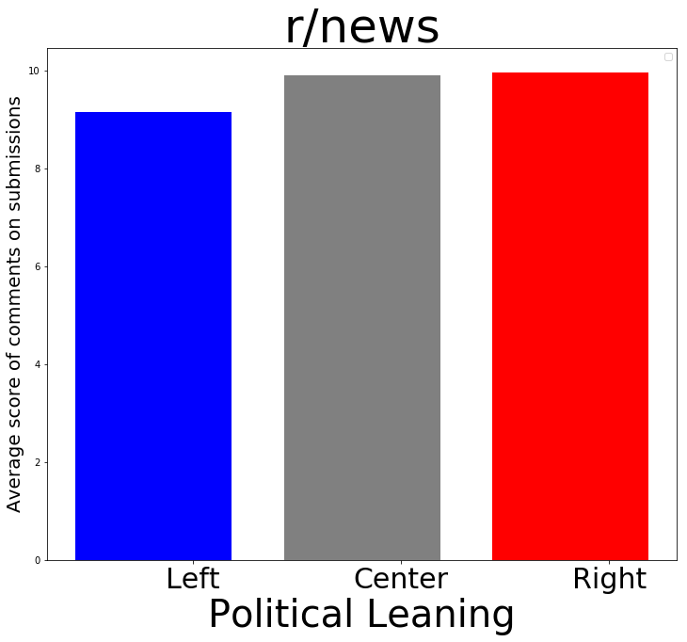

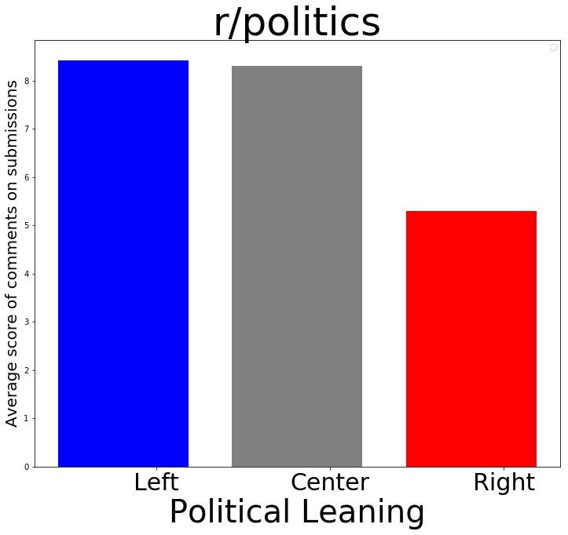
Media bias: engagement on submissions by leaning
Average upvotes per comment on submissions.

Slide 15
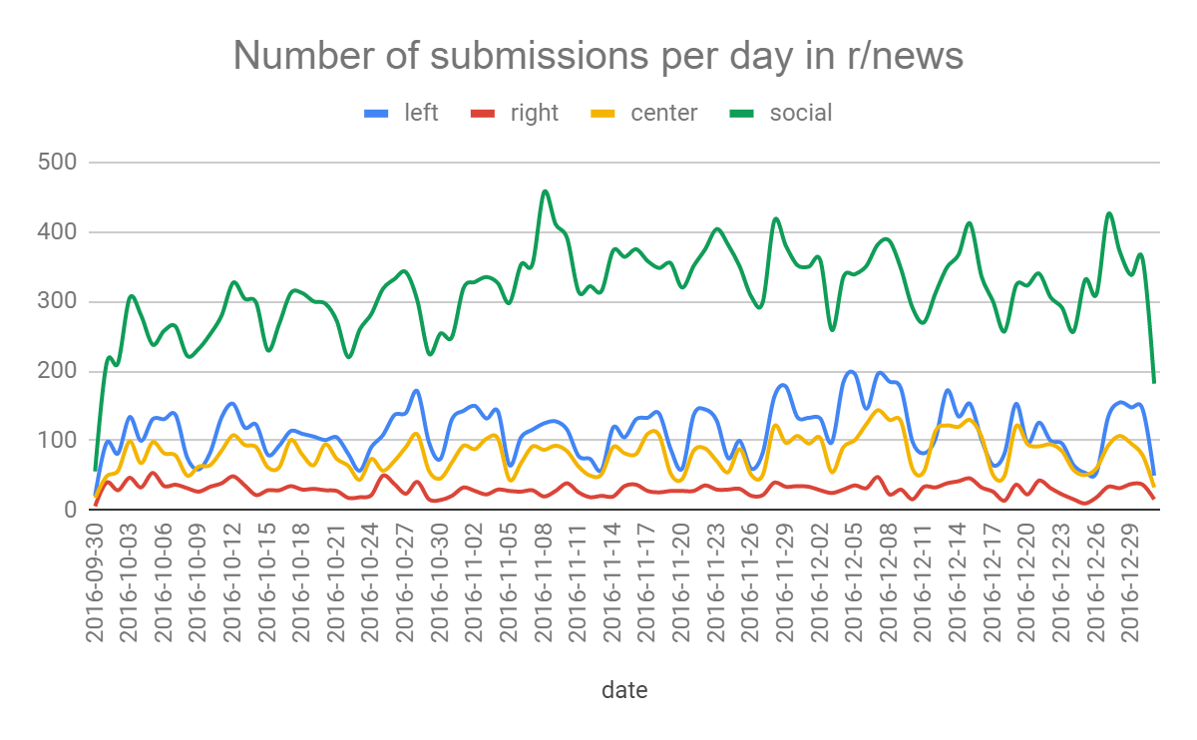
Following the election: tracking activity over time

Slide 16
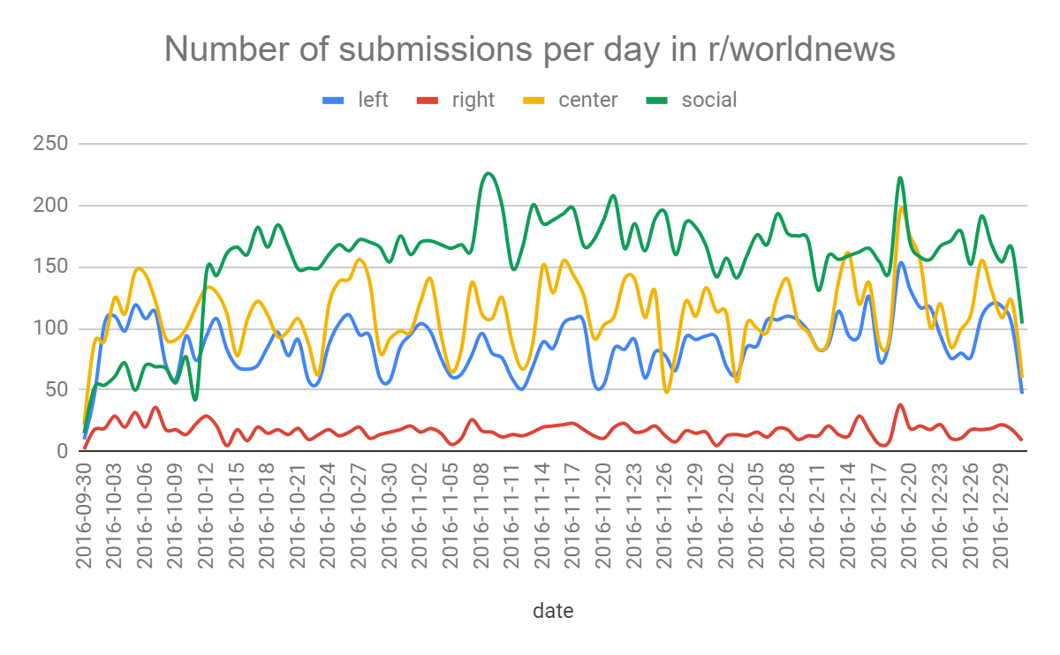
Following the election: tracking activity over time

Slide 17
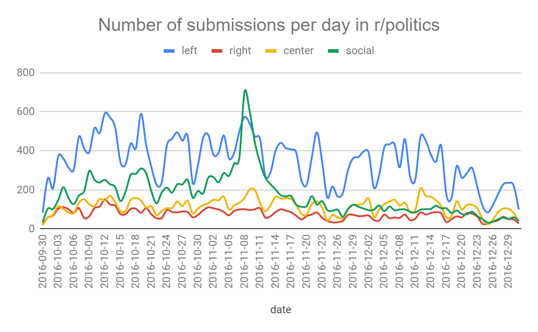
Following the election: tracking activity over time

Slide 18
RQ 2: Does the identity of a media outlet predict a submission’s popularity and engagement?
We use media bias ratings obtained from AllSides to classify submissions as quoting news from either left-, right-, or center-leaning media outlets We then create a dataset with features that include a semantic representation of submissions’ title, the political leaning of their source, its historic popularity, and the time of day the submission is made
https://www.allsides.com/media-bias/media-bias-chart

Slide 19
An unfair correlation? Political leaning of news source predicts expected popularity and engagement on r/news
feature | # comments | # upvotes
center | 0.01960 | 0.01528
left | 0.04158 | 0.03076
other | -0.01770 | -0.01026
right | 0.00541 | -0.00072
evening | -0.01392 | -0.01322
morning | 0.01254 | 0.01148
night | -0.00727 | -0.00657
noon | 0.01138 | 0.01086
source leaning
submission time

Slide 20
RQ 2: Community engagement on neutral ground
We extract all cross-posting users, i.e., those who post in both partisan subreddits as well as in neutral subreddits We compare the representation of users from both sides of the aisle in the neutral subreddits
hillaryclinton democrats Liberal
The_Donald Republican Conservative
news worldnews politics

Slide 21
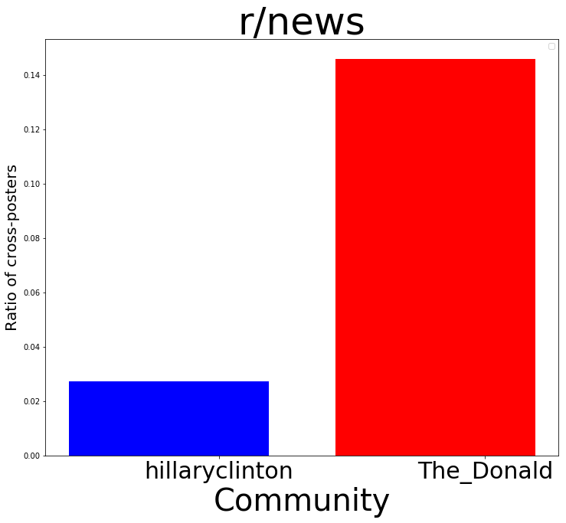
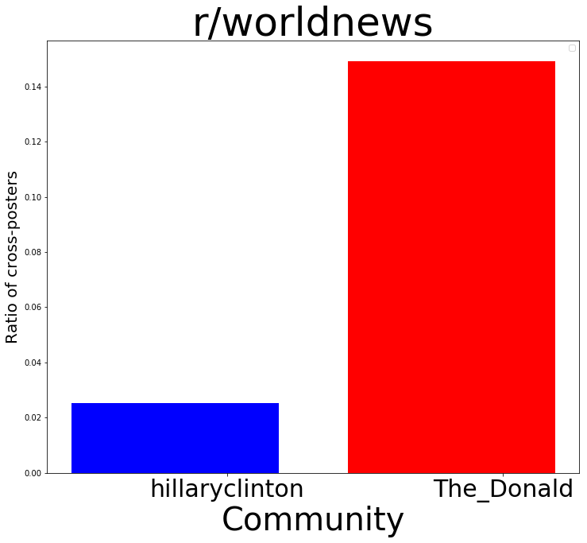
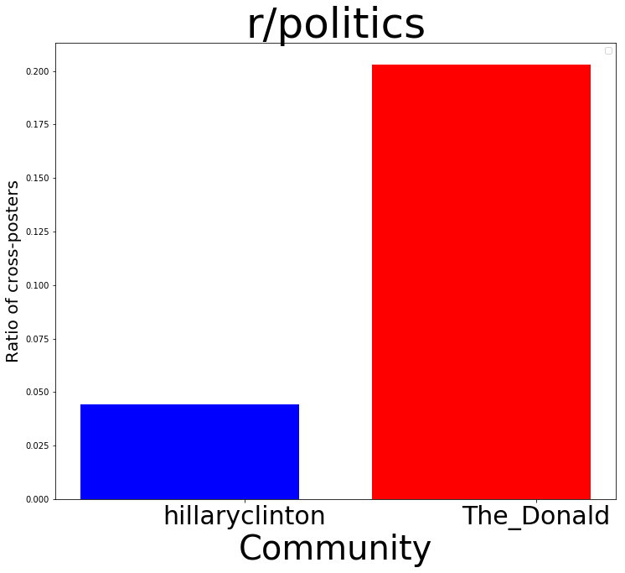
Community engagement: representation on neutral ground
Users from The_Donald post more frequently than those from hillaryclinton.

Slide 22
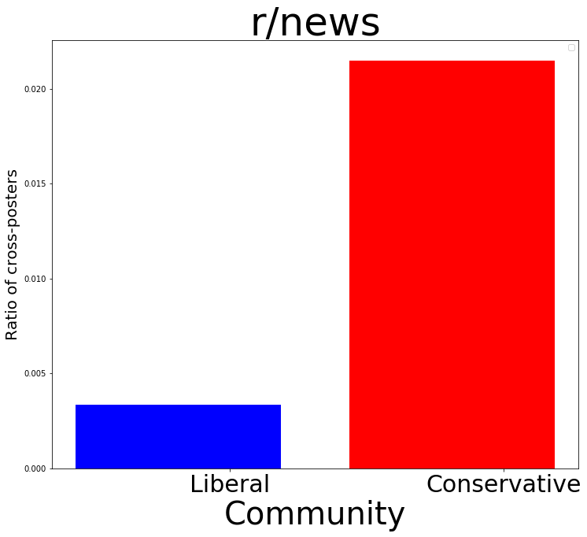

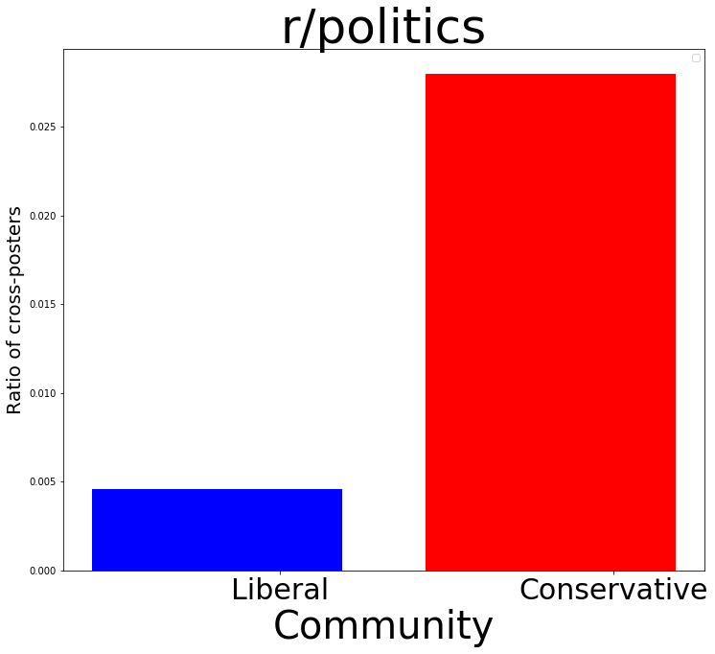
Community engagement: representation on neutral ground
Users from Conservative post more frequently than those from Liberal.

Slide 23
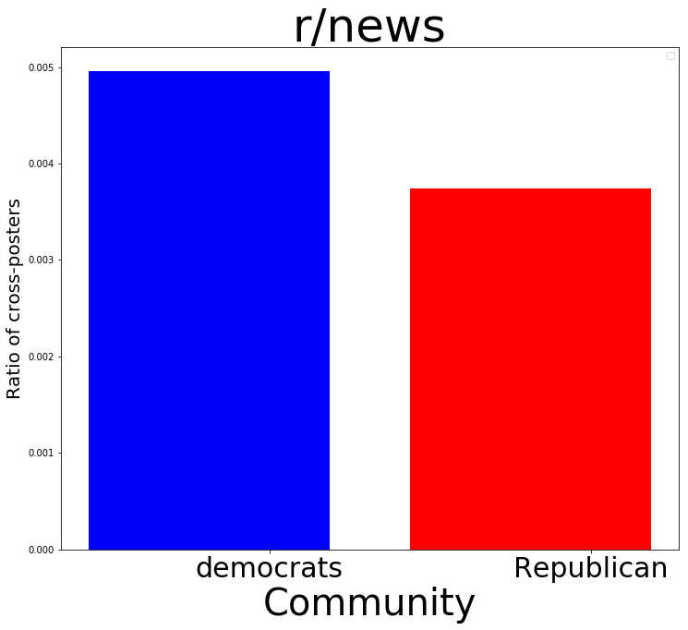
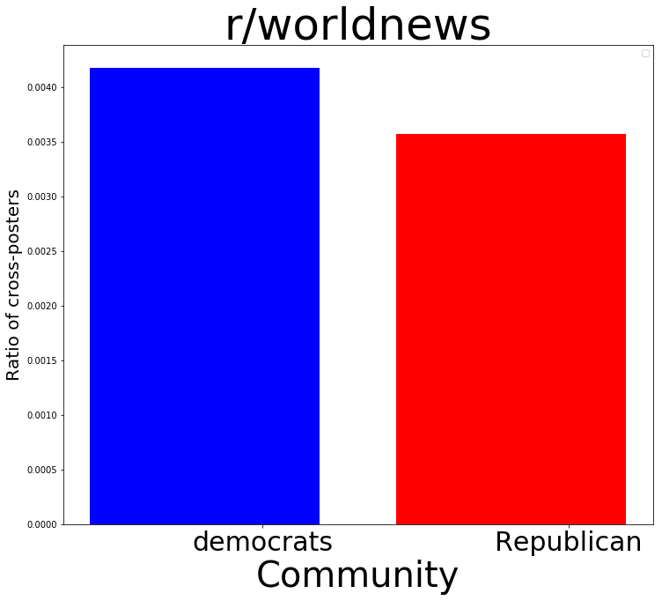
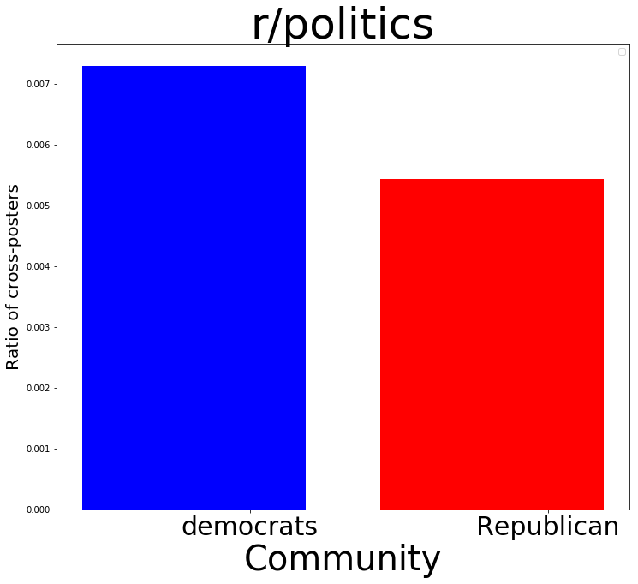
Community engagement: representation on neutral ground
Users from democrats post more frequently than those from Republican, although their numbers are comparable.

Slide 24
RQ 4: Mining sentiment surrounding political actors
We extract all comments that contain mentions of political actors and entities from both parties We compare average sentiment expressed by the community for these actors and entities in locally- and globally-focused subreddits
Hutto and Gilbert, VADER: A Parsimonious Rule-based Model for Sentiment Analysis of Social Media Text, ICWSM 2014

Slide 25
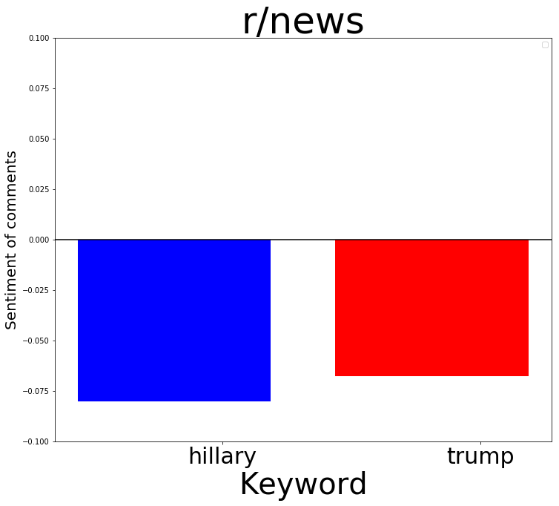
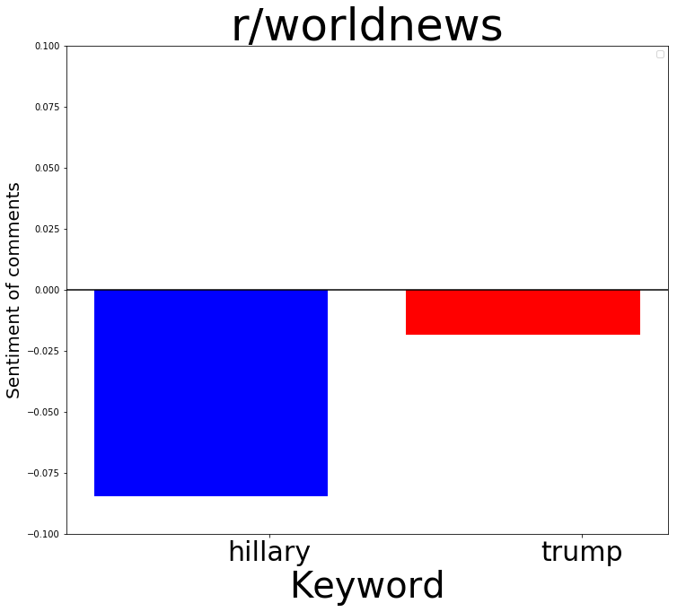
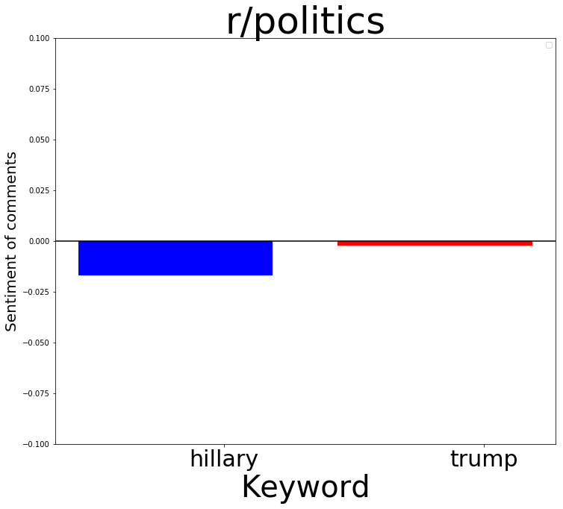
Mining sentiment: comparing local and global attitudes towards political actors and entities
Hillary is disliked more than Trump locally, but even more so in r/worldnews (!)

Slide 26
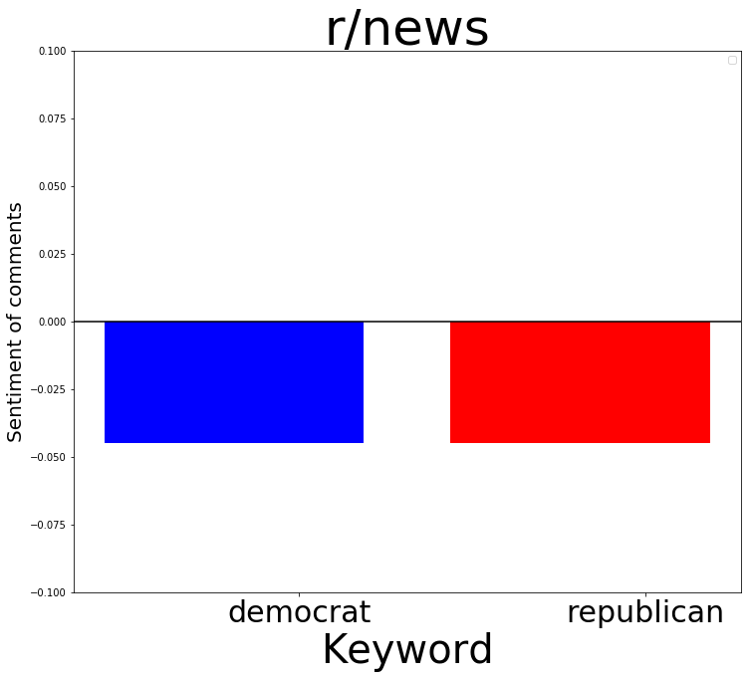
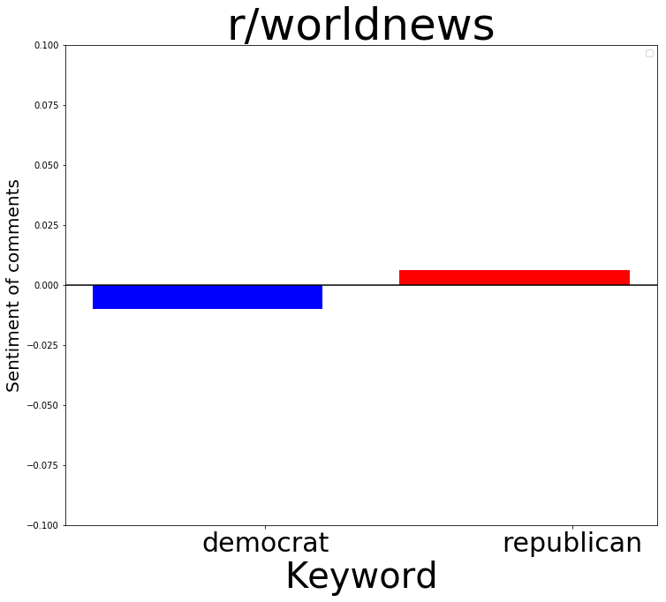
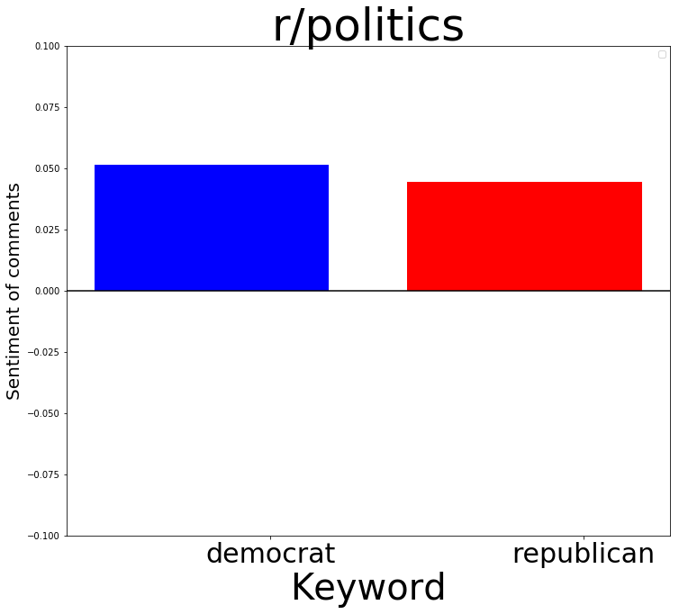
Mining sentiment: comparing local and global attitudes towards political actors and entities
Democrats disliked and Republicans liked in r/worldnews

Slide 27
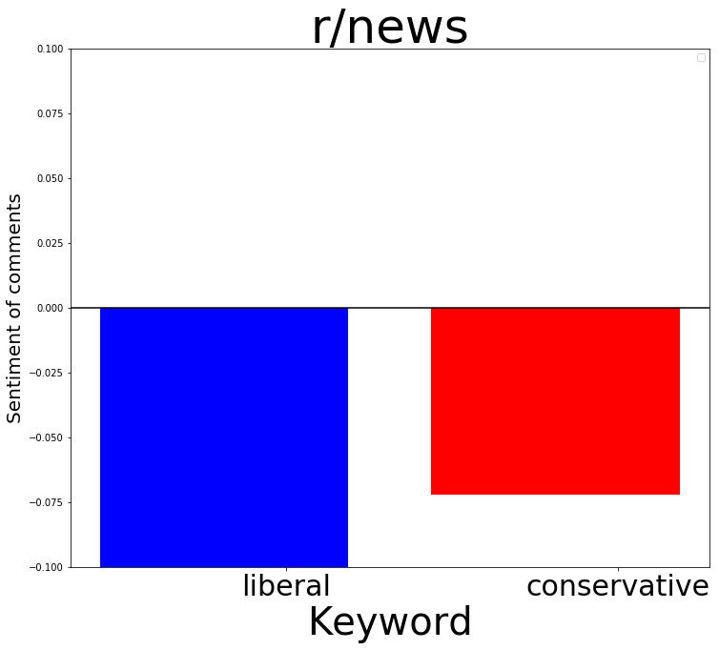
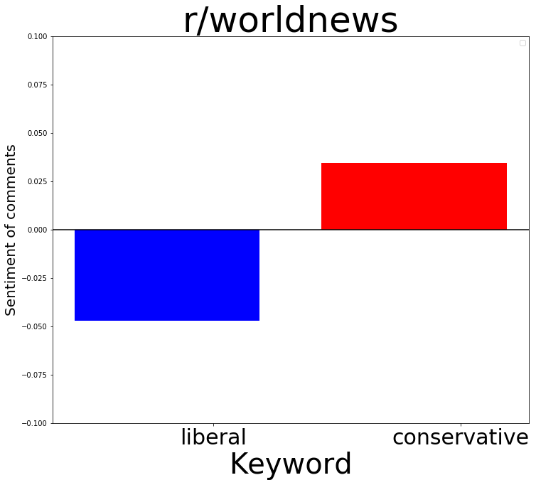
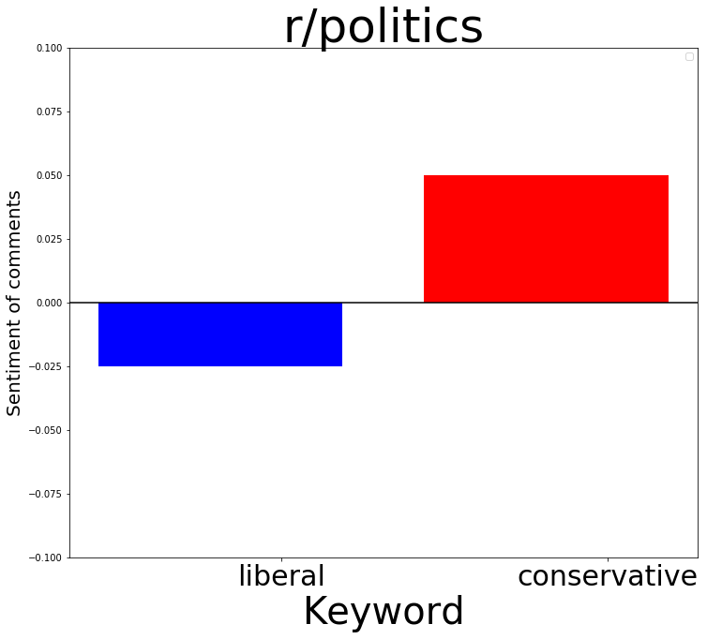
Mining sentiment: comparing local and global attitudes towards political actors and entities
Liberals disliked and conservatives liked in r/worldnews

Slide 28
RQ 5: Comparing semantic representations of political entities in local and global discourse
We train word embeddings on comment corpora collected from r/news and r/worldnews We compare the semantic representations of entities in local and global discourse, as well as in right-wing and left-wing Conversations, by inspecting their nearest neighbors in the space
Mikolov et. al., Distributed representations of words and phrases and their compositionality, NeurIPS 2013

Slide 29
Comparing semantic representations of political entities: r/news vs /worldnews
r/news hillary: clinton, hilary, hrc, bernie, trump, sanders, shillary, stein, obama, dnc, killary, clintons, hillarys, romney, djt, jill, mccain, superdelegates, kasich, hitlery
r/worldnews
hillary: clinton, hilary, hrc, bernie, sanders, trump, obama, clintons, dnc, gop, killary, romney, dws, shillary, she, donna, rnc, democrats, candidate, jeb

Slide 30
Comparing semantic representations of political entities: r/news vs /worldnews
r/news trump: hillary, hrc, hilary, drumpf, obama, trumpler, clinton, bernie, djt, tump, sanders, ukip, trumps, killary, shillary, trumo, putin, gop, hilliary, hitlery
r/worldnews
trump: hillary, obama, putin, hilary, clinton, drumpf, duterte, hrc, he, bernie, netanyahu, sarkozy, bibi, du30, sanders, him, trumpler, trumps, gop, duerte

Slide 31
Comparing semantic representations of political entities: right- vs left-leaning subreddits
r/hillaryclinton, r/democrats, r/Liberal hillary: hrc, trump, hilary, clinton, her, obama, she, bernie, sanders, bill, kaine, him, tpp, candidate, stein, he, dnc, chelsea, hers, ellison
r/The_Donald, r/Republican, r/Conservative
hillary: hilary, hrc, killary, shillary, hiliary, hitlery, hilliary, trump, illary, crooked, clinton, she, bernie, hilldog, hilllary, obama, hillery, hitlary, sanders, killery

Slide 32
Comparing semantic representations of political entities: right- vs left-leaning subreddits
r/hillaryclinton, r/democrats r/Liberal
trump: hillary, hrc, clinton, him, drumpf, pence, he, trumps, dt, obama, romney, rubio, bernie, putin, assad, hilary, his, sander, sanders, himself
r/The_Donald, r/Republican, r/Conservative
trump: djt, hillary, shillary, hilary, killary, bernie, dt, him, he, hrc, pence, tump, hitlery, romney, obama, sanders, clinton, gop, hilldog, hiliary

Slide 33
Conclusion & future work
Left-leaning media outlets are quoted more often in local U.S. news and political subreddits, and they receive more engagement as well
The global news subreddits are more centrist than U.S. ones, which means we may have a lesson to learn from the rest of the world
Social media rises as a popular source for news during important, time-sensitive events, e.g. the result of the 2016 election
The right-wing community is overrepresented in comparison to the left-wing community in the news and politics subreddits
We find clear differences in the sentiment associated with and semantic representations of political actors and entities in local and global subreddits

Slide 34
Conclusion & future work
Thus far we have been dealing with a late pivot in the project and wrangling with a large amount of data; in the future we plan to:
Expand the list of media outlets classified by political leaning to improve coverage in submissions
Evaluate controversiality of submissions with respect to their news source and political subject
Create communities of users by connecting them based on activity in common subreddits across the entire website, and use it to discover other subreddits that are correlated with people’s political leaning
Use the lessons learned here to inform the development of a framework to encourage a well-balanced diet in news recommendation

Slide 35
Thank You

